Slide 1
ATACseqQC
Jianhong Ou
Haibo Liu
Julie Zhu
Ou et.al., 2018. doi: 10.1186/s12864-018-4559-3
Notes:
Hello. Thank you for attending advanced bioinformatics. I am Jianhong. Today I will introduce ATACseqQC, a package for ATAC-seq quality control and preprocess. Please do not be hesitate to stop me when you have any question.

Slide 2
4C
5C
HiC
Dnase-seq
FAIRE-seq
ATAC-seq
The ENCODE Project Consortium 2011. doi: 10.1371/journal.pbio.1001046
Notes:
There are multiple methods to check chromatin accessibility from higher-order, such as 4C, 5C and HiC to detect the topology associating domain (TAD), to primary-order, such as Mnase-seq, Dnase-seq, FAIRE-seq and ATACseq. Study the open chromatin profile can help us to understand cis or trans-regulatory elements, such as enhancers, repressors, silencers, insulators, promoters, transcription factor binding sites.

Slide 3
Publish time
MNase-seq doi: 10.1016/j.cell.2008.02.022
DNase-seq doi: 10.1101/pdb.prot5384
Mar. 2008
Oct. 2013
Mar. 2009
Feb. 2010
FAIRE-seq doi: 10.1016/j.ymeth.2009.03.003
ATAC-seq doi: 10.1038/nmeth.2688
Notes:
Current, there are 4 most popular genome-wide high-throughput chromatin accessibility assays.
Mnase-seq, FAIRE-seq and DNase-seq are published almost in the same time.
In 2013, GreenLeaf lab published ATAC-seq (Assay for Transposase-Accessible Chromatin using sequencing),
And address that: The method is a fast and sensitive alternative to DNase-seq for assaying chromatin accessibility genome-wide, or to MNase-seq for assaying nucleosome positions in accessible regions of the genome.

Slide 4
The ATAC-seq datasets submitted to GEO
library(SRAdb)
sqlfile <- getSRAdbFile()
sra_con <- dbConnect(SQLite(),sqlfile)
(sra_tables <- dbListTables(sra_con))
dbListFields(sra_con,"sra")
library_strategy <-
dbGetQuery(sra_con,
'SELECT library_strategy,
COUNT(*) AS count
FROM sra
GROUP BY library_strategy')
subs <- library_strategy[
library_strategy$library_strategy %in%
c("ATAC-seq", "FAIRE-seq",
"MNase-Seq", "DNase-Hypersensitivity"), ]
barplot(subs$count)
FAIRE-seq
116
DNase-Seq
4076
MNase-Seq
6647
ATAC-seq
21236
Notes:
I count the experiment numbers submitted to GEO this Monday. Compare to other methods, ATAC-seq is most widely used method for profiling chromatin accessibility.

Slide 5
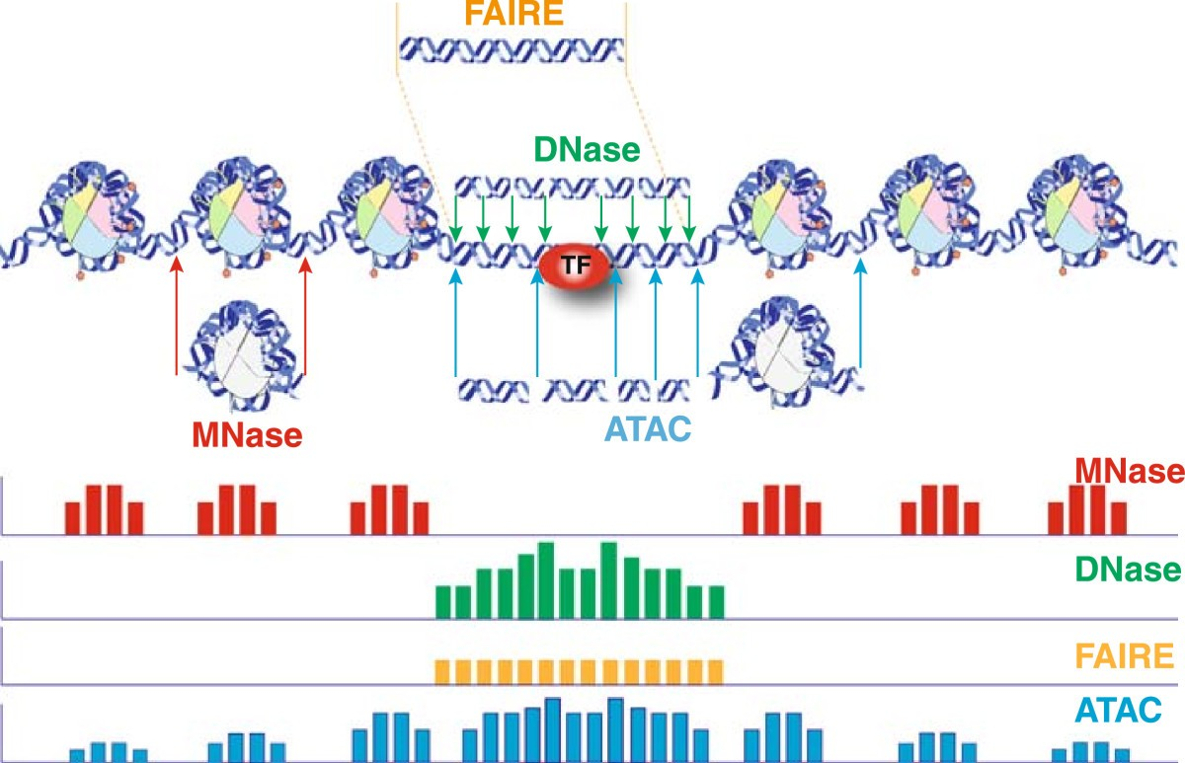
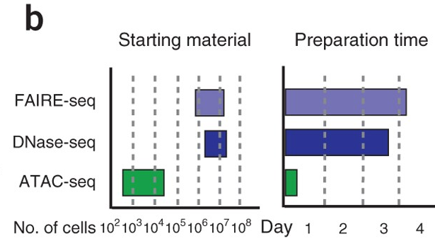
Methods for profiling
chromatin accessibility
Why ATAC-seq
rapid and sensitive
comprehensive profile
Ref: Buenrostro et.al., 2013. doi: 10.1038/nmeth.2688
Ref: Tsompana and Buck. 2014. doi: 10.1186/1756-8935-7-33
Notes:
Why ATACseq is so popular, there are two majority reasons: 1. rapid and sensitive, 2. comprehensive profile. It requires less starting material and preparation time. ATAC-seq provide not only the open chromatin information but also the TF and nucleosome occupancy information.
Compare to DNase-seq (Duke, Greg Crawford Lab, linyun Song) and FAIRE-seq (University of North Carolina, UNC) , the majority open chromatin are identical to DNAseq and FAIRE-seq.
Genomic target: MNase: nucleosome, DNase and FAIRE: open chromatin, ATAC: open chromatin, TF and nucleosome occupancy

Slide 6
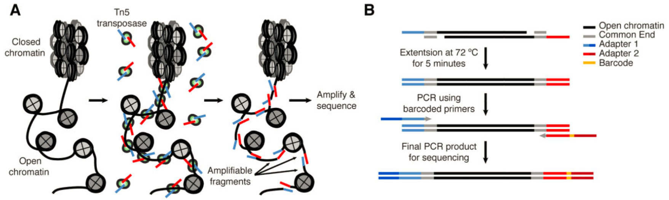
Ref: Buenrostro et.al., 2015. doi: 10.1002/0471142727.mb2129s109
ATAC-seq is a simple two-step protocol
Insertion of Tn5 transposase with adaptors
PCR amplification
Notes:
And it is really easy to perform. ATAC-seq is a simple 2-step protocol:
Insertion of Tn5 transposase with adaptors
PCR amplification.

Slide 7

Question to be answered in QC
Q: Does the sequencing succeed?
S: fastQC
K: sequencing score (or mapping score)
library complexity (duplicates rate)
Q: Does the library provide information of open chromatin, TF and nucleosome occupancy?
S: ATACseqQC
K: periodicity fragment size distribution
TSSs enrichment for nucleosome-free fragments
detectability of genome-wide TF occupancy
Notes:
When we got the sequence results, many researchers ask me a question, how about the quality of my ATAC-seq. Indeed, this question can be separated into two layers:
First, Does the sequencing succeed? This can be answered by fastQC and some sam or bam tools by testing the sequencing score, and duplicates rate.
Second, does the library provide information of open chromatin? This can be answered by ATACseqQC. ATACseqQC will provide information about the fragment size distribution, TSSs enrichment, and genome-wide TF occupancy.

Slide 8
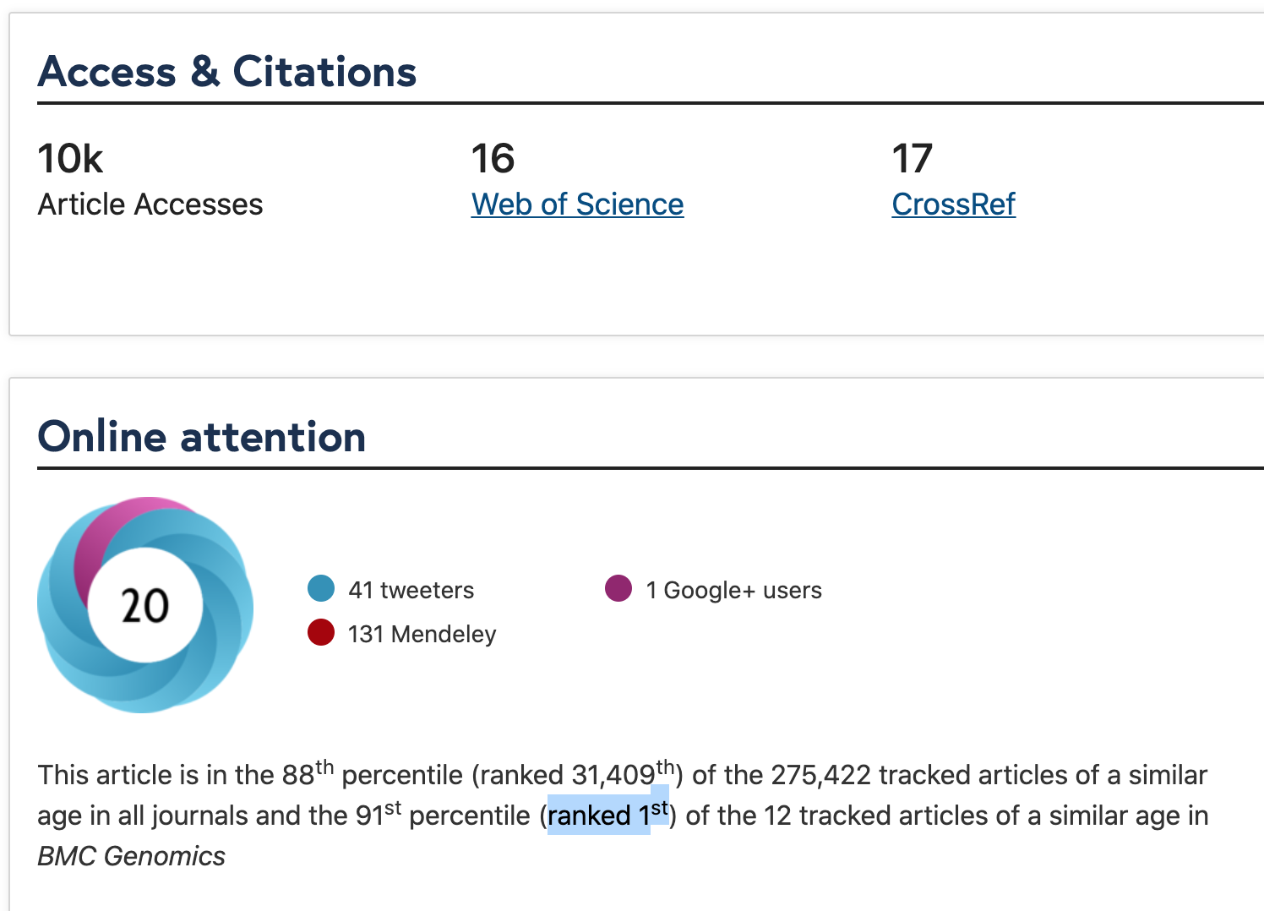
Why ATACseqQC
Well documented
Well maintained
Bioconductor support site
Easy to use
Provide files for downstream analysis
cross platform
Notes:
Being a Bioconductor package, of course, ATACseqQC must be well documented and maintained. There are daily building system to test the package is up to date. It is cross platform tools. It also provide multiple method to get help from authors, such as Bioconductor support site, or email communication with the authors. It is easy to use. You only requires basic R experience. It also provide the files for downstream analysis.
In BMC Genomics similar age papers, it is ranked top 1 level online attention.

Slide 9
Prepare sample data set
Sample data is downloaded from https://www.ncbi.nlm.nih.gov/geo/query/acc.cgi?acc=GSM1155959
align
trim
filter
Ref: Buenrostro et.al., 2013. doi: 10.1038/nmeth.2688
Notes:
The sample data for this workshop is prepared from the original ATAC-seq paper of Greenleaf’s lab, published in nature methods. The reads were downloaded from GEO and then processed with multiple steps,
Trim the adaptor, align to human genome, filter unwanted reads such as duplicates and chrM reads.

Slide 10

Prepare for inputs
## set the working directory,
## replace "~/Downloads/ATACseqQCworkshop" by your path
wd <- "~/Downloads/ATACseqQCworkshop"
dir.create(wd)
setwd(wd)
library(BiocManager)
install("jianhong/workshop2020")
## input the sample bamFile from the installed packaged
## the data is pre-processed chr1 data of GSM1155959
extfilePath <- system.file("extdata", "ATACseqQC",
package="workshop2020", mustWork = TRUE)
dir(extfilePath)## see what we have in extdata/ATACseqQC directory
## [1] "GL3.chr1.bam" "GL3.chr1.bam.bai"
## [3] "GL3.chr1.rmdup.bam" "GL3.chr1.rmdup.bam.bai"
https://github.com/jianhong/workshop2020
https://bioconductor.org/packages/ATACseqQC
Notes:
We can use the prepared sample data in the package or download a sample data for this workshop. The sample data included in the package is replicate1 in the nature comm paper. The sample data for this workshop is replicate 3. I will wait for about 5 min for you to download the data. An alternative method is that you can follow the vignette of ATACseqQC. https://bioconductor.org/packages/devel/bioc/vignettes/ATACseqQC/inst/doc/ATACseqQC.html

Slide 11
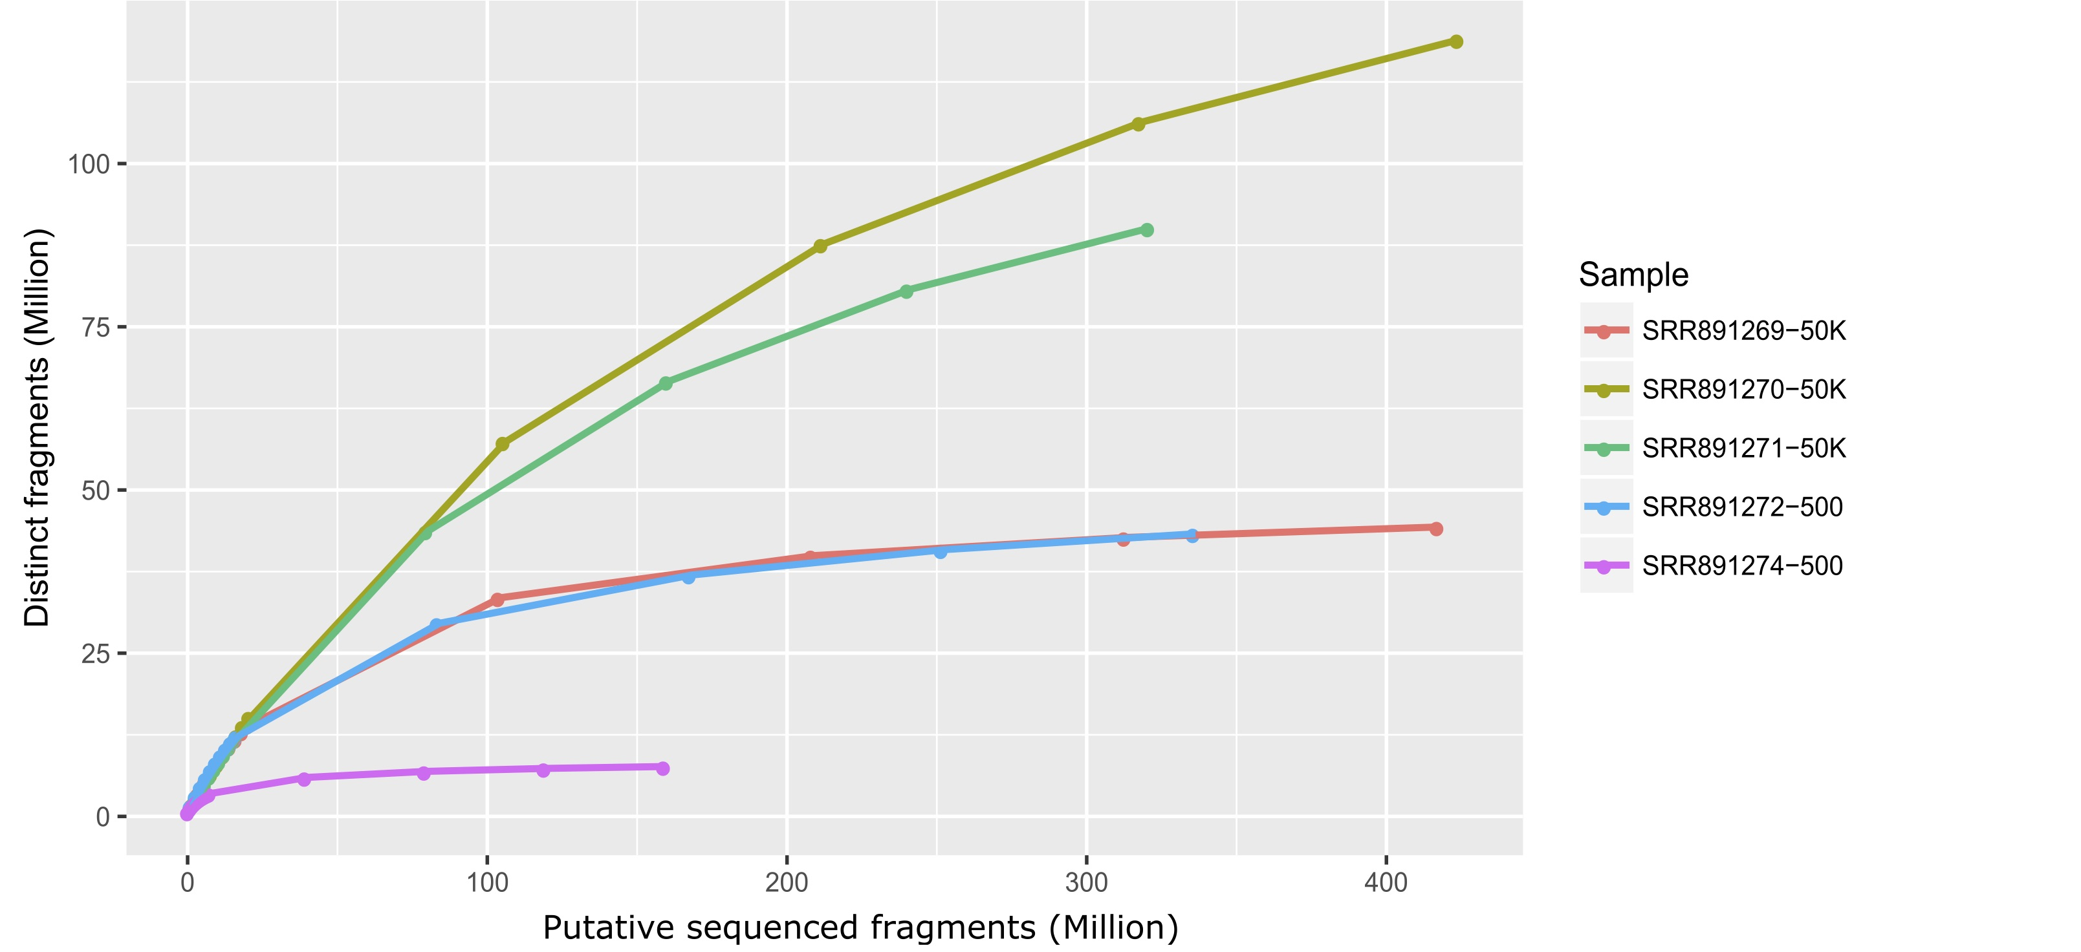
Library complexity
Ou et.al., 2018. doi: 10.1186/s12864-018-4559-3
Notes:
Library complexity is checking the duplicated reads. We want higher complexity which means low duplicated rate.
This figure show the library complexity of multiple samples. The purple line and blue lines are the samples from 500 cells. The green, red and brown lines are the samples from 50K cells. We can see that more starting materials, we get higher library complexity.

Slide 12
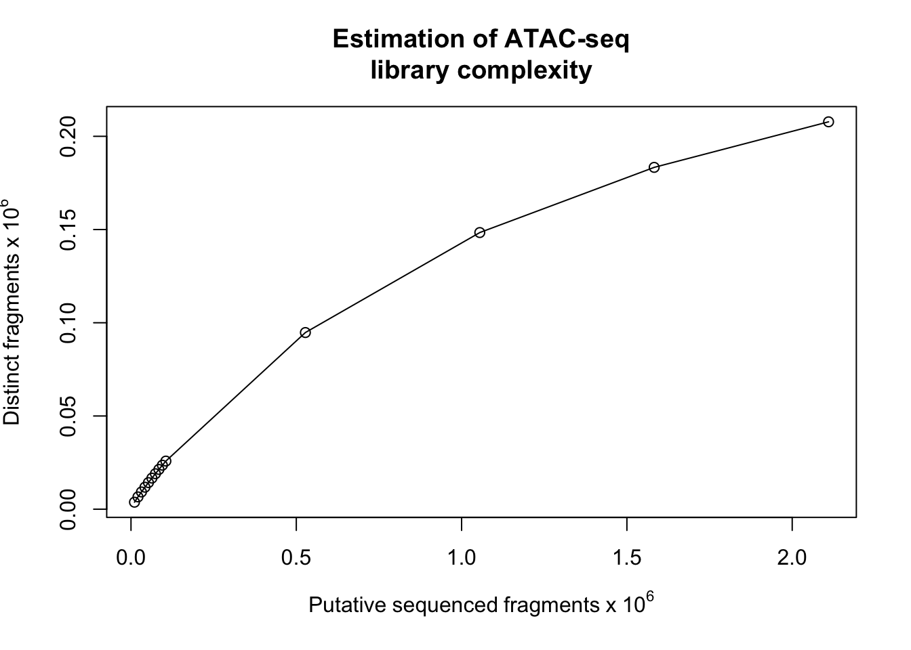
Estimate the library complexity
## load the library
library(ATACseqQC)
## mapping status, such as mapping rate,
## duplicate rate, genome-wide distribution,
## mapping quality, and contamination.
## NOTE: requires sorted BAM files with duplicate reads marked as input.
## library complexity
estimateLibComplexity(readsDupFreq(file.path(extfilePath, "GL3.chr1.bam")))
Typical ATAC-seq peak
Low-complexity ATAC-seq peak
Notes:
The library complexity can be checked by estimateLibComplexity function. Please note that in this step, the duplicate reads should not be removed. Otherwise the complexity will be overestimated.
Here I use a cartoon to illustrate the low-complexity ATAC-seq peak and a high-complexity peak. We can see for low-complexity, most of the reads are duplicated reads, which means they share the same start position and end position. Low-complexity means you need to reduce the PCR circles, or increase the transposase reaction, or increase the start materials.

Slide 13
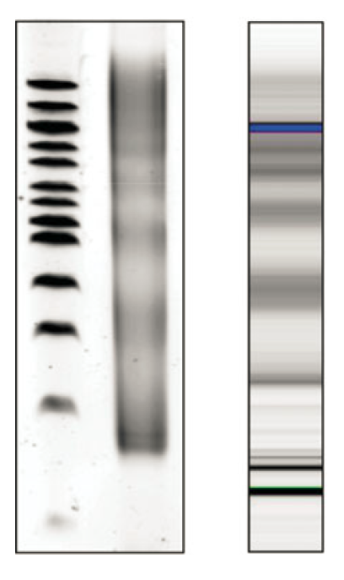
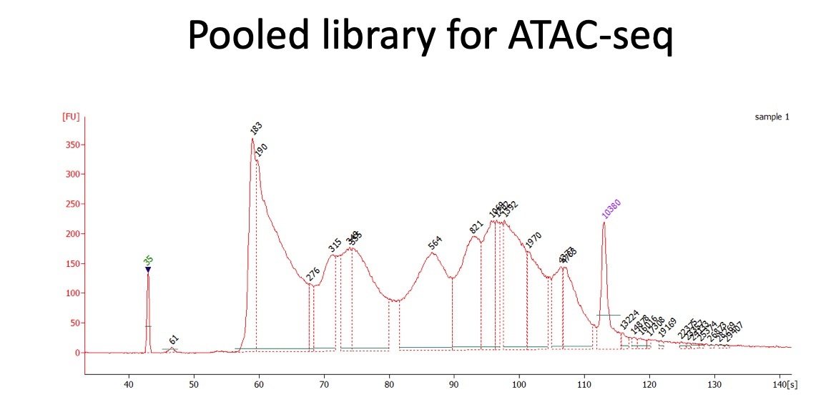
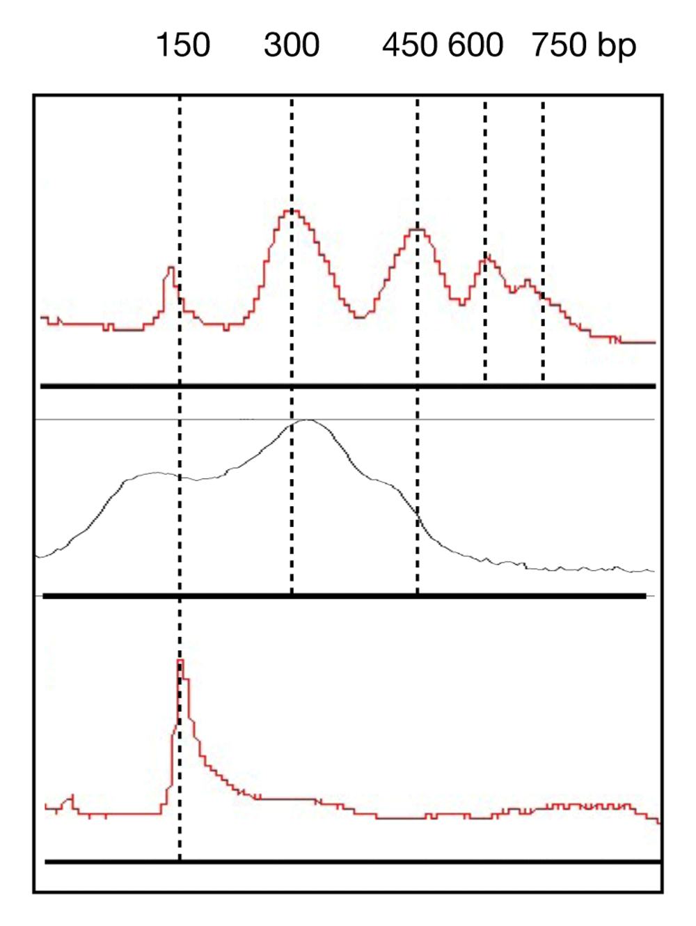
ATAC-seq library fragmentation profile
Library fragment size
Agarose Gel
Bioanalyzer
Good example
bp
400
Good
200
Need to be improved
Adapter/primer
Dimer (<200 nt)
or nucleosome-free fragment
(dimer+80)
bad
Ref: Buenrostro et.al., 2015. doi: 10.1002/0471142727.mb2129s109
Ref: Augusto et.al., 2020. doi: 10.12688/wellcomeopenres.15552.1
Notes:
Before we sequence, we can check the library quality by run electrophoresis through a 1.5% agarose gel or on a Bioanalyzer chip. A ladder that corresponds to the nucleosome-free region and multiple nucleosome-size fragments should be seen (one nucleosome = about 150 bp). Ideally, five bands should be obtained, three bands are acceptable. A single band at around 150 bp indicates sample degradation or over-fragmentation.
(X-axis) Base pairs. (Y-axis) Fluorescence intensity. Peaks correspond to nucleosome-free region, mono- to tetra-nucleosome fractions.
Middle lane: too strong fragmentation, thus Tn5 incubation time needs to be decreased.
Bottom lane: too strong empty insertion.

Slide 14
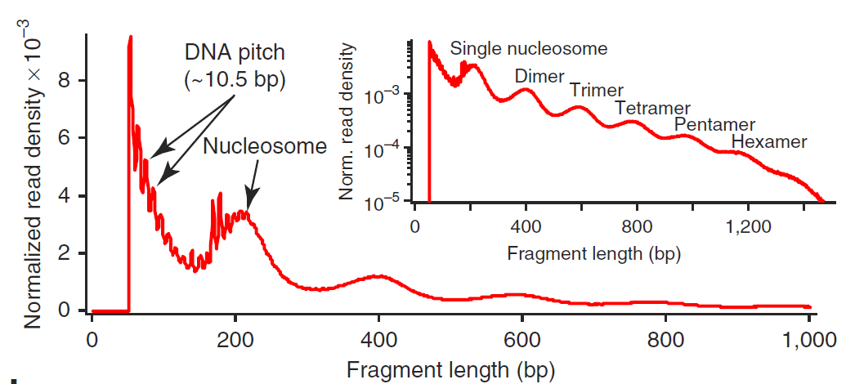

ATAC-seq library Insertion profile
Library fragment size
Agarose Gel
Bioanalyzer
Library insert size (=size in gel – adapter/primer size)
bp
400
200
Ref: Buenrostro et.al., 2013. doi: 10.1038/nmeth.2688
Must be Paired End reads
fragSizeDist(bamfile, bamfile.labels)
Function in ATACseqQC
Ref: Buenrostro et.al., 2015. doi: 10.1002/0471142727.mb2129s109
Notes:
ATACseqQC can calculate the insertion size profile. Please note that the fragment size calculated by ATACseqQC is different from the size in gel. It is equal to the size in gel subtracted the adapter size. You can see the single nucleosome bind in gel is about 300bp, where in the fragment size profile calculated by ATACseqQC, it becomes 200bp.

Slide 15
ATAC-seq library fragmentation profile
nucleosome
Transposase
TF
PolII
Nucleosome-free fragments
mono-nucleosome
di-nucleosome
Ref: Buenrostro et.al., 2015. doi: 10.1002/0471142727.mb2129s109
tri-nucleosome
Notes:
We suppose that the nucleosome-free fragments size are smaller than 100 nt. A single nucleosome protected fragment is usually about 200 nt. So a di-nucleosome protected fragment is about 400 nt. And so on. This is the reason why we see the ladders in fragmentation profile.

Slide 16


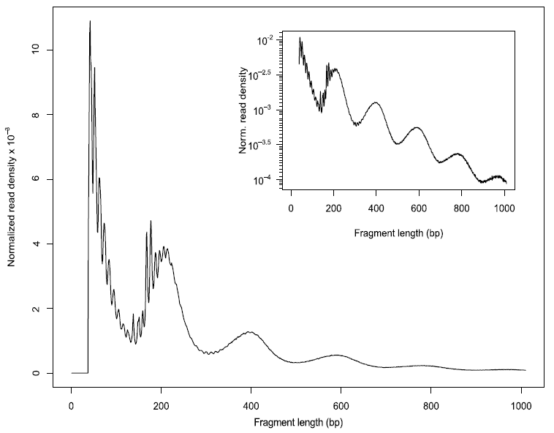
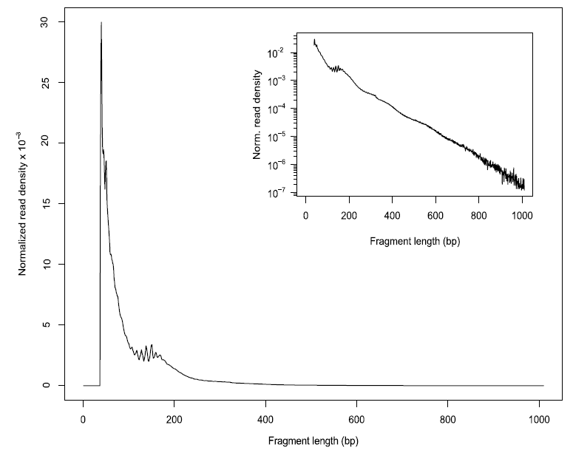
Assessing insert size distribution
A (High quality)
B (Poor quality)
Ref: Ou et.al., 2018. doi: 10.1186/s12864-018-4559-3
Notes:
Here we can see a high-quality profile and a poor-quality profile. First, there should be a large proportion of reads with less than 100 bp, which represents the nucleosome-free region. Second, the fragment size distribution should have a clear periodicity, which is evident in the inset figure, indicative of nucleosome occupancy (present in integer multiples).

Slide 17
Minimal criteria for insert size distribution
You must see in the distribution of insert size:
A nucleosome-free region (NFR) peak
A mono-nucleosome region peak (147~294 bp).
Notes:
The minimal criteria for insert size distribution is that you must see two peaks in the figure: a nucleosome-free region and a mono-nucleosome region.

Slide 18
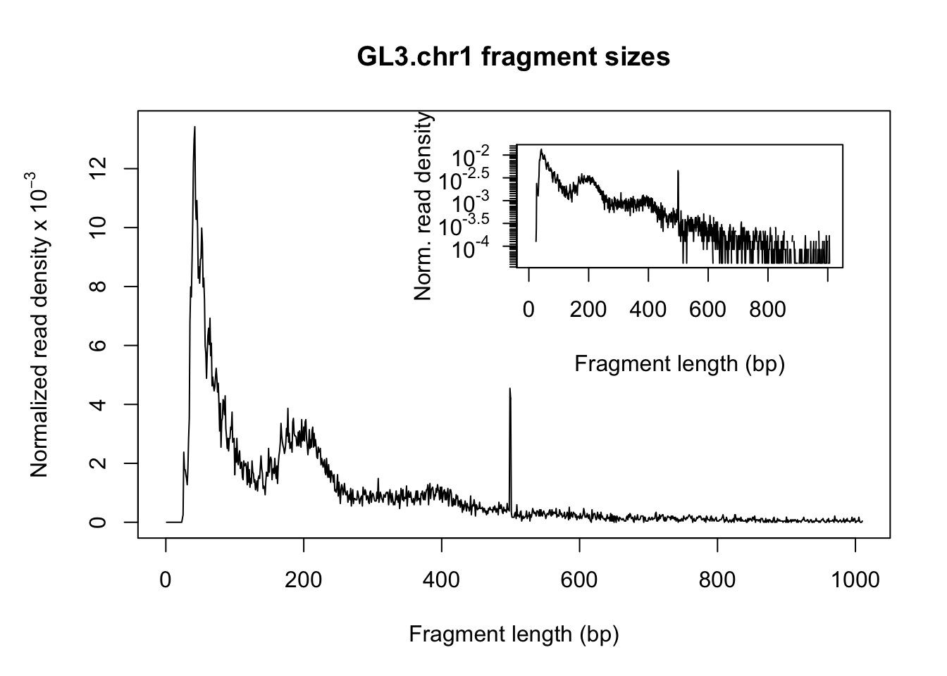
Assessing insert size distribution
First, there should be a large proportion of reads with less than 100 bp, which represents the nucleosome-free region. Second, the fragment size distribution should have a clear periodicity, which is evident in the inset figure, indicative of nucleosome occupancy (present in integer multiples).
## set bam file name, replace file.path(extfilePath, "GL3.chr1.rmdup.bam")
## by your bam file name
bamfile <- file.path(extfilePath, "GL3.chr1.rmdup.bam" )
(bamfile.labels <- gsub(".rmdup.bam", "", basename(bamfile)))
## [1] "GL3.chr1”
## generate fragment size distribution
fragSize <- fragSizeDist(bamfile, bamfile.labels)
Notes:
To assess the insert size distribution, first we assign the bam file path, and we assign a label for the sample. And then run fragSizeDist. It will generate the figure of fragment size distribution.

Slide 19
Shifting aligned reads
adapter1
9 bp staggered cut
>
adapter2
5'
123456789
987654321
Random position
Transposase Mix
3'
>
9 bp gap
5'
123456789
3'
987654321
Transesterification reaction
9 bp gap
Center of insertion
PCR primer
5'
123456789
3'
987654321
PCR primer
PCR primer
Notes:
To perform the downstream analysis, the first step is that to shift the aligned reads to correct position.
ATAC-seq use Nextera Tn5 transposase Nextera kit. The kit contain transposase mix, which is the transposase dimers. The dimers already connected with adapters.
The transposase will random cut the open chromatin region, and then connect the adapter into the cutting site. We can see here a 9 bp gap for the second strand. When the adapter ligated in the cutting site, we can use primer to amplify the fragments between two cutting position.
The center of insertion is in the middle of 9 nucleotides. In the Greenleaf lab paper, they correct the reads position by move the read in positive strand for 4 bp and negative strand 5bp.

Slide 20
Shifting aligned reads
SAM file example
## bamfile tags to be read in
possibleTag <- combn(LETTERS, 2)
possibleTag <- c(paste0(possibleTag[1, ], possibleTag[2, ]),
paste0(possibleTag[2, ], possibleTag[1, ]))
library(Rsamtools)
## use top 100 reads to test possible tags
bamTop100 <- scanBam(BamFile(bamfile, yieldSize = 100),
param = ScanBamParam(tag=possibleTag))[[1]]$tag
tags <- names(bamTop100)[lengths(bamTop100)==100]
tags
## [1] "AS" "MD" "PG" "XG" "NM" "XM" "XN" "XO" "XS" "YS" "YT"
## files will be output into outPath
outPath <- "splited"
dir.create(outPath)
## shift the coordinates of 5'ends of alignments in the bam file
library(BSgenome.Hsapiens.UCSC.hg38)
seqlev <- "chr1" ## subsample data for quick run
which <- as(seqinfo(Hsapiens)[seqlev], "GRanges")
gal <- readBamFile(bamfile, tag=tags, which=which,
asMates=TRUE, bigFile=TRUE)
shiftedBamfile <- file.path(outPath, "shifted.bam")
gal1 <- shiftGAlignmentsList(gal, outbam=shiftedBamfile)
@HD VN:1.6 SO:coordinate
@SQ SN:ref LN:45
r001 99 ch1 7 30 8M2I4M = 37 39 TTAGATAAAGGCTG *
r002 0 ch1 9 30 3S6M. * 0 0 AAAAGATAAGGATA *
r003 0 ch1 9 30 5S6M * 0 0 GCCTAAGCTAA * SA:Z:ref,29,-,6H5M,17,0;
r004 0 ch1 16 30 6M14M * 0 0 ATAGCTTCAGC *
r003 2064 ch1 29 17 6H5M * 0 0 TAGGC * SA:Z:ref,9,+,5S6M,30,1;
r001 147 ch1 37 30 9M. = 7 -39 CAGCGGCAT * NM:i:1
The alignment section: mandatory fields
Col | Field | Type | Brief description
1 | QNAME | String | Query template
2 | FLAG | Int | bitwise FLAG
3 | RNAME | String | Reference sequence NAME
4 | POS | Int | 1-based leftmost mapping POSition
5 | MAPQ | Int | MAPping Quality
6 | CIGAR | String | CIGAR string
7 | RNEXT | String | Reference name of the mate/next read
8 | PNEXT | Int | Position of the mate/next read
9 | TLEN | Int | observed Template LENgth
10 | SEQ | String | segment SEQuence
11 | QUAL | String | ASCII of Phred-scaled base QUALity+33
The alignment section: optional fields
All optional fields follow the TAG:TYPE:VALUE format where TAG is a two-character string that matches /[A-Za-z][A-Za-z0-9]/. Each TAG can only appear once in one alignment line.
https://samtools.github.io/hts-specs/SAMv1.pdf https://en.wikipedia.org/wiki/SAM_(file_format)
Notes:
Tn5 transposase has been shown to bind as a dimer and inserts two adaptors into accessible DNA locations separated by 9 bp.
Therefore, for downstream analysis, such as peak-calling and footprinting, all reads in input bamfile need to be shifted.
If you already know the tags in your bam file, you can directly assign the tags. Otherwise, you can use this script to guess what tags you have in the bam file. Here we use top 100 reads to test possible tags. Of cause, there may be missing tags in the top hundred reads. If you got error, you need to re-assign the tags and re-run the shift again.
Here we use splited as the output path.
The function shiftGAlignmentsList can be used to shift the reads. By default, all reads aligning to the positive strand are offset by +4bp, and all reads aligning to the negative strand are offset by -5bp.
The adjusted reads will be written into a new bamfile for peak calling or footprinting.

Slide 21
Errors when Shifting aligned reads
> gal1 <- shiftGAlignmentsList(gal, outbam=shiftedBamfile) [E::sam_parse1] unrecognized type N [W::sam_read1] Parse error at line 26
> gal1 <- shiftGAlignmentsList(gal, outbam=shiftedBamfile.outPath)
[bam_translate] PG tag "MarkDuplicates" on read "M01263:122:000000000-CWJNL:1:2106:23406:17450" encountered with no corresponding entry in header, tag lost. Unknown tags are only reported once per input file for each tag ID.
[bam_translate] PG tag "MarkDuplicates" on read "M01263:122:000000000-CWJNL:1:2104:12761:8947" encountered with no corresponding entry in header, tag lost. Unknown tags are only reported once per input file for each tag ID.
tags <- tags[tags != "PG"]
Notes:
Here I show 2 typical errors of shifting step. The error is caused by missing or unknown tag in the bam file. You may want to try to remove the tags which caused the issue and retry it again. For example here we need to remove the PG tag from the list according the error message.

Slide 22
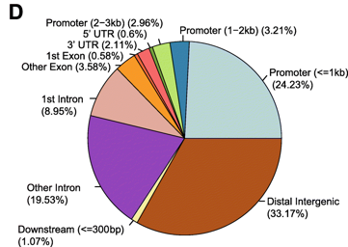
Enrichment in promoters
PTscore
High PTscore
Low PTscore
P
T
P
T
Promoter/Transcript body score
PT score is calculated as the coverage of promoter divided by the coverage of its transcript body. PT score will show if the signal is enriched in promoters.
TSS
TSS
TSSEscore
High TSSEscore
Low TSSEscore
Transcription Start Site (TSS) Enrichment Score
TSS enrichment score is a ratio between aggregate distribution of reads centered on TSSs and that flanking the corresponding TSSs. TSS score = the depth of TSS (1000 bp each side) / the depth of end flanks (100bp each end).
Typical peak annotation pie chart
Ref: Yan et.al.,2020. doi: 10.1186/s13059-020-1929-3
Notes:
Typical peak annotation pie chart shows that around 25% of the peaks are in promoter regions. The ATAC-seq reads will show a tendency to enrich in promoters. We implement PTscore and TSSEscore to check that. Those score can also be combined with RNA-seq data to see the correlation between open chromatin regions and gene expression.
PT score is calculated as the coverage of promoter divided by the coverage of its transcript body. PT score will show if the signal is enriched in promoters.
TSS enrichment score is a ratio between aggregate distribution of reads centered on TSSs and that flanking the corresponding TSSs. TSS score = the depth of TSS (1000 bp each side) / the depth of end flanks (100bp each end).

Slide 23
PT score
A (High quality)
B (Poor quality)
Ref: Ou et.al., 2018. doi: 10.1186/s12864-018-4559-3
Notes:
Here is the simulated plots of high-quality and poor-quality ATAC-seq for PTscores. We can see in poor-quality ATAC-seq, the PTscore is almost random distributed around 0. where, for high-quality ATAC-seq, we can see many genes show enriched reads in promoter region compare to the transcript body part.

Slide 24
TSSE score
A (High quality)
B (Poor quality)
Ref: Ou et.al., 2018. doi: 10.1186/s12864-018-4559-3
Notes:
Here is the simulated plots of high-quality and poor-quality ATAC-seq for TSSEscore. We can see in poor-quality ATAC-seq, the log2 transformed TSSEscore is almost random distributed around 0. where, for high-quality ATAC-seq, we can see many genes show enriched reads in promoter region compare to the nearby flanking.

Slide 25
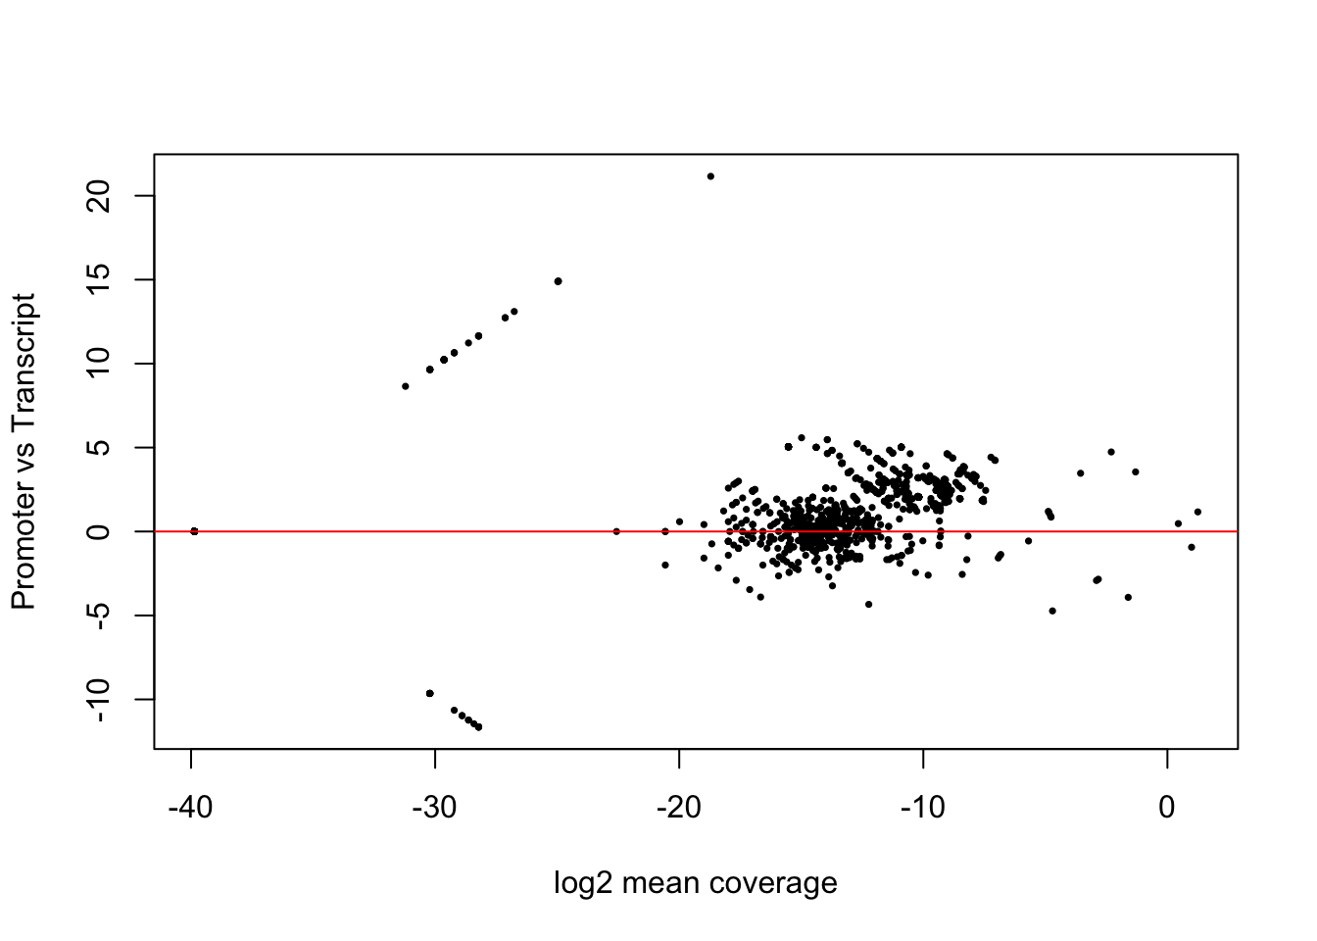
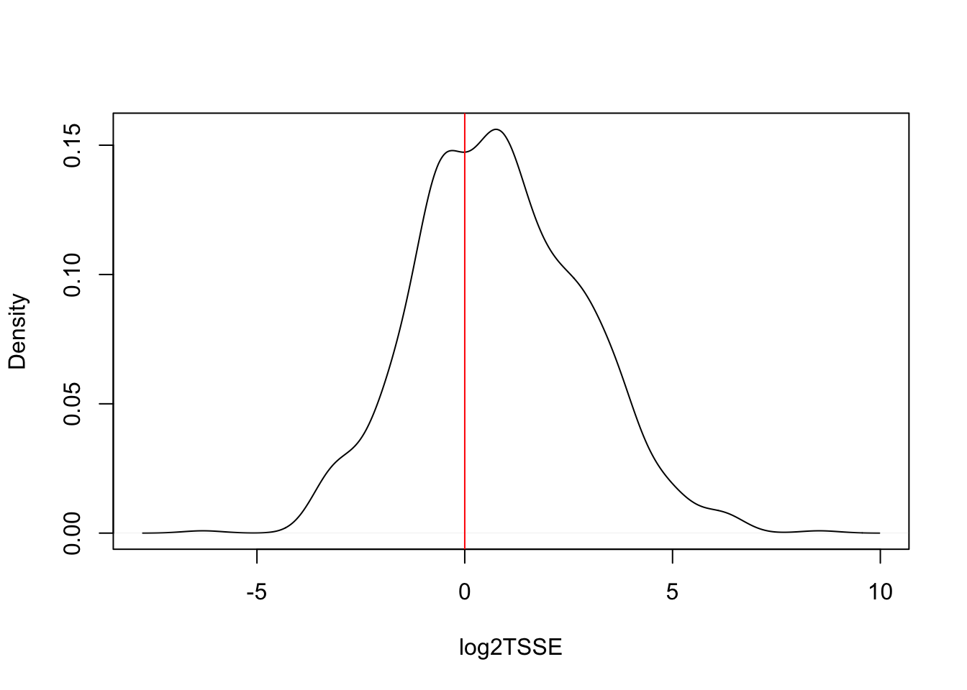
Enrichment in promoters
library(TxDb.Hsapiens.UCSC.hg38.knownGene)
txs <- transcripts(TxDb.Hsapiens.UCSC.hg38.knownGene)
pt <- PTscore(gal1, txs)
plot(pt$log2meanCoverage, pt$PT_score, pch=16, cex = .5,
xlab="log2 mean coverage", ylab="Promoter vs Transcript")
abline(h=0, col="red")
tsse <- TSSEscore(gal1, txs)
log2TSSE <- log2(tsse$TSS.enrichment.score)
log2TSSE <- log2TSSE[!is.na(log2TSSE)]
plot(density(log2TSSE), xlab = "log2TSSE", main = "")
abline(v=0, col="red")
Notes:
Here we use PTscore function and TSSEscore function to calculate the PTscore and TSSEscore. The input is the object of shifted reads. We also need the transcripts annotation info.

Slide 26
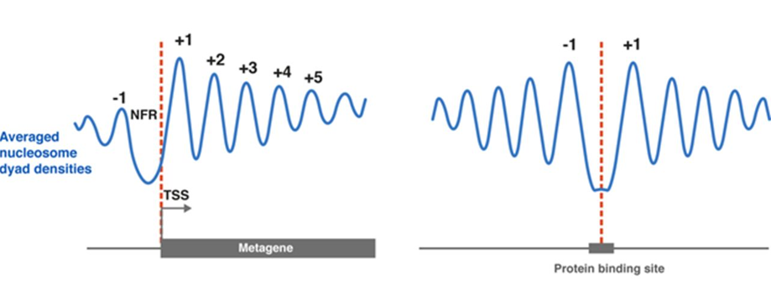
Nucleosome positioning around TSSs and TF-bound sites
Ref: Klemm et.al., 2019. doi: 10.1038/s41576-018-0089-8
Ref: Baldi. 2018 doi: 10.1042/EBC20180058
Notes:
This figure show the different stage of chromatin: the closed chromatin, open chromatin, and the stage between them. ATAC-seq can also be used for nucleosome positioning. Ideally, we could observe the periodicity of nucleosome around the TF protected or nucleosome free region. This can be visualized by metagene analysis.
The typical pattern that is observed when nucleosome dyad densities of expressed genes are averaged and aligned at TSSs.
Phased arrays around insulator protein and transcription factor binding sites are revealed by averaging and aligning nucleosome dyad densities at the respective protein sites.

Slide 27
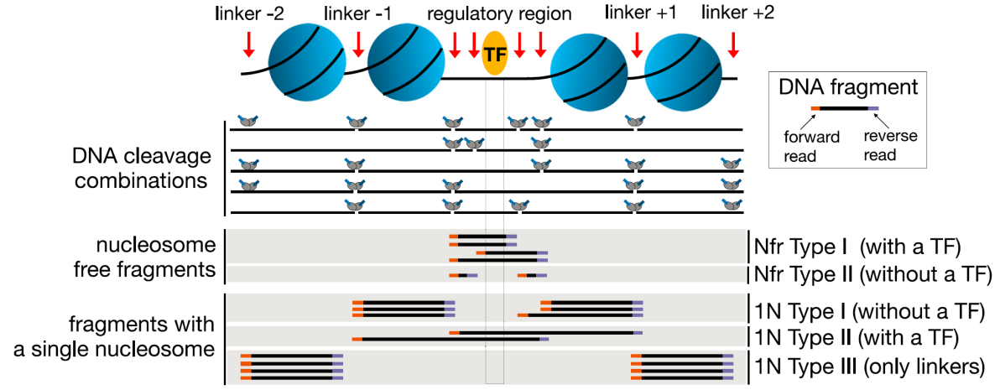
Splitting BAM files
split aligned reads into different bins:
Nucleosome-free
Mononucleosome
Dinucleosome
Trinucleosome
Li et al. 2019. doi: 10.1186/s13059-019-1642-2
objs <- splitGAlignmentsByCut(gal1, txs=txs,
genome=genome, outPath = outPath)
Notes:
To plot the heatmap and profile of nucleosome-free and nucleosome occupancy, the first step is to separate the reads into nucleosome-free or not groups. This step can be do by splitGAlignmentsByCut function.
As we can see here, the separator step is mainly depended on the fragment size. The annotations and conservations also can be considered.

Slide 28
Split reads
## run program for chromosome 1 only
txs <- txs[seqnames(txs) %in% "chr1"]
genome <- Hsapiens
## split the reads into NucleosomeFree, mononucleosome,
## dinucleosome and trinucleosome.
## and save the binned alignments into bam files.
objs <- splitGAlignmentsByCut(gal1, txs=txs, genome=genome, outPath = outPath)
## list the files generated by splitGAlignmentsByCut.
dir(outPath)
## [1] "dinucleosome.bam" "dinucleosome.bam.bai" "inter1.bam"
## [4] "inter1.bam.bai" "inter2.bam" "inter2.bam.bai"
## [7] "inter3.bam" "inter3.bam.bai" "mononucleosome.bam"
## [10] "mononucleosome.bam.bai" "NucleosomeFree.bam" "NucleosomeFree.bam.bai"
## [13] "others.bam" "others.bam.bai" "shifted.bam"
## [16] "shifted.bam.bai" "trinucleosome.bam" "trinucleosome.bam.bai"
Notes:
The shifted reads will be split into different bins, namely nucleosome free, mononucleosome, dinucleosome, and trinucleosome. Shifted reads that do not fit into any of the above bins will be discarded. Splitting reads is a time-consuming step because we are using random forest to classify the fragments based on fragment length, GC content and conservation scores.
By default, we assign the top 10% of short reads (reads below 100_bp) as nucleosome-free regions and the top 10% of intermediate length reads as (reads between 180 and 247 bp) mononucleosome. This serves as the training set to classify the rest of the fragments using random forest. The number of the tree will be set to 2 times of square root of the length of the training set.

Slide 29
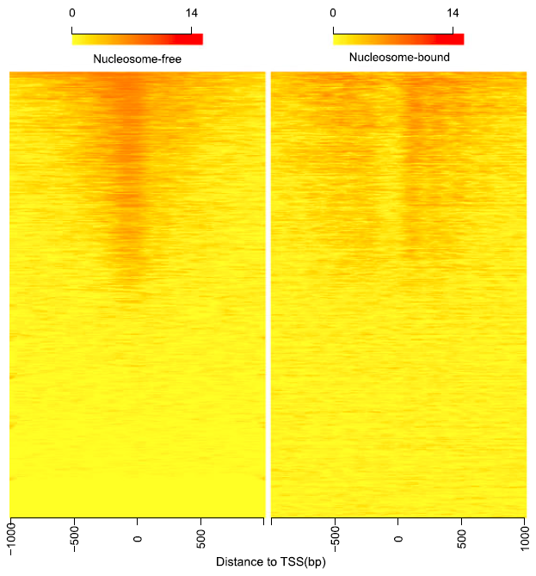
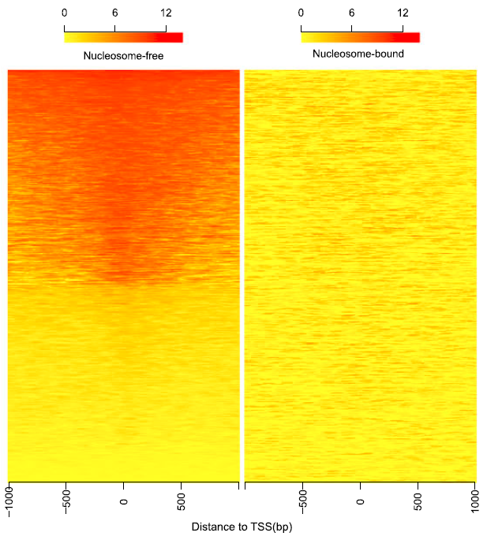
Heatmaps showing distribution of reads from different bins around TSSs
A (High quality)
B (Poor quality)
Ref: Ou et.al., 2018. doi: 10.1186/s12864-018-4559-3
Notes:
By averaging the signal across all active TSSs, we should observe that nucleosome-free fragments are enriched at the TSSs, whereas the nucleosome-bound fragments should be enriched both upstream and downstream of the active TSSs. Because ATAC-seq reads are concentrated at regions of open chromatin, users should see a strong nucleosome signal at the +1 nucleosome, but the signal decreases at the +2, +3 and +4 nucleosomes.

Slide 30
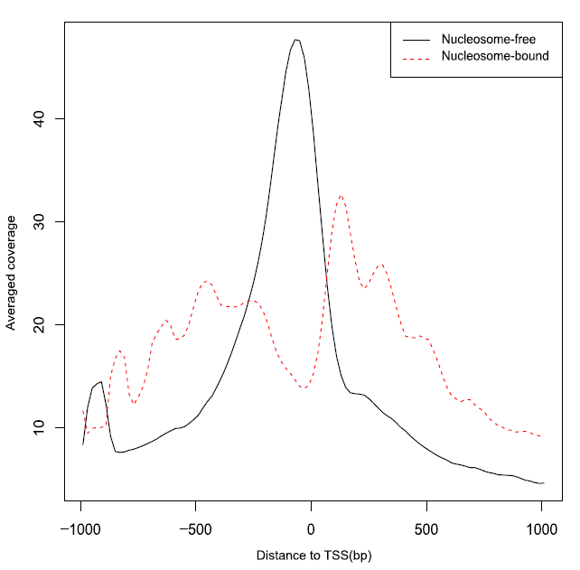
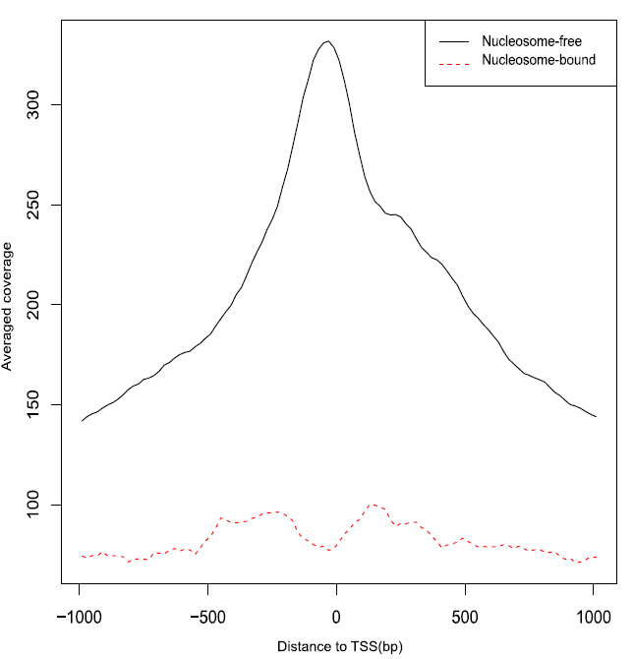
Density plots showing distribution of reads from different bins around TSSs
A (High quality)
B (Poor quality)
Ref: Ou et.al., 2018. doi: 10.1186/s12864-018-4559-3
Notes:
The profile of the heatmap make the distribution more obviously.

Slide 31
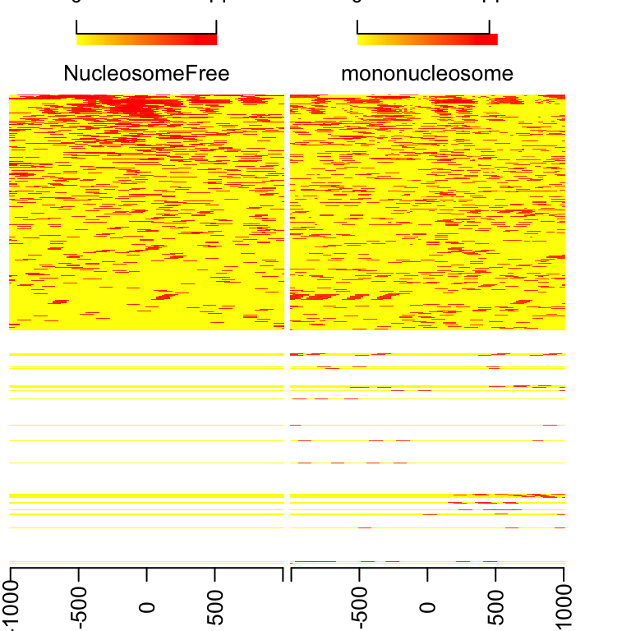
Heatmap for nucleosome positions
library(ChIPpeakAnno)
bamfiles <- file.path(outPath,
c("NucleosomeFree.bam", "mononucleosome.bam",
"dinucleosome.bam", "trinucleosome.bam"))
TSS <- promoters(txs, upstream=0, downstream=1)
TSS <- unique(TSS)
## estimate the library size for normalization
(librarySize <- estLibSize(bamfiles))
## splited/NucleosomeFree.bam splited/mononucleosome.bam
## 10140 3426
## splited/dinucleosome.bam splited/trinucleosome.bam
## 2748 0
## calculate the signals around TSSs.
NTILE <- 101
dws <- ups <- 1010
sigs <- enrichedFragments(gal=objs[c("NucleosomeFree", "mononucleosome",
"dinucleosome", "trinucleosome")],
TSS=TSS, librarySize=librarySize, seqlev=seqlev,
TSS.filter=0.5, n.tile = NTILE,
upstream = ups, downstream = dws)
## log2 transformed signals
sigs.log2 <- lapply(sigs, function(.ele) log2(.ele+1))
featureAlignedHeatmap(sigs.log2, reCenterPeaks(TSS, width=ups+dws),
zeroAt=.5, n.tile=NTILE) #plot heatmap
Notes:
To plot the heatmap, we use enrichedFragments function to do metagene analysis and the plot the heatmap by ChIPpeakAnno featureAlignedHeatmap function.

Slide 32
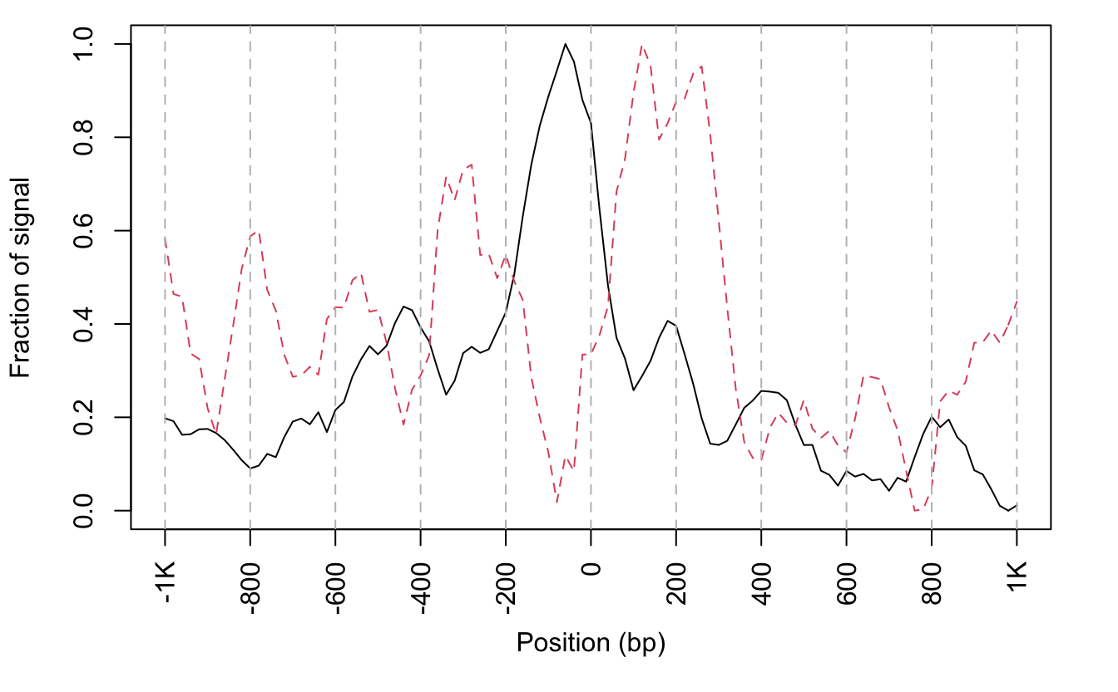
Coverage curve for nucleosome positions
## get signals normalized for nucleosome-free and nucleosome-bound regions.
out <- featureAlignedDistribution(sigs, reCenterPeaks(TSS, width=ups+dws),
zeroAt=.5, n.tile=NTILE, type="l", ylab="Averaged coverage")
## rescale the nucleosome-free and nucleosome signals to 0~1
range01 <- function(x){(x-min(x))/(max(x)-min(x))}
out <- apply(out, 2, range01)
matplot(out, type="l", xaxt="n", xlab="Position (bp)", ylab="Fraction of signal")
axis(1, at=seq(0, 100, by=10)+1, labels=c("-1K", seq(-800, 800, by=200), "1K"), las=2)
abline(v=seq(0, 100, by=10)+1, lty=2, col="gray")
Notes:
The script shown here is used to emphasize the nucleosome positions. Here I showed is the rescaled plot.

Slide 33
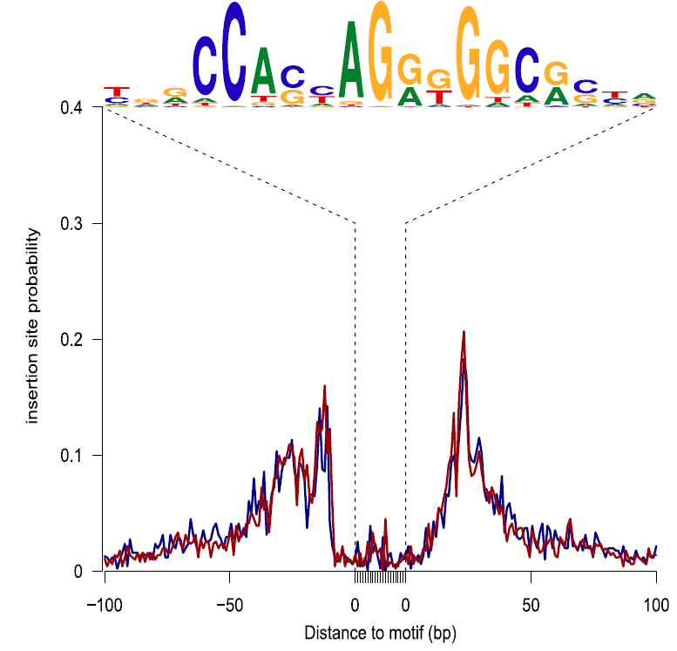
Assessing footprints of DNA-binding factors
## get PWM of TFs
CTCF <- query(MotifDb, c("CTCF"))
CTCF <- as.list(CTCF)
sigs <- factorFootprints(shiftedBamFile, pfm=CTCF[[1]],
genome=genome, min.score="90%", seqlev=seqlev,
upstream=100, downstream=100)
Ref: Ou et.al., 2018. doi: 10.1186/s12864-018-4559-3
Ref: Sung et.al., 2016. doi: 10.1038/nmeth.3766
Notes:
The factorFootprints function can be used to assessing footprints of DNA-binding factors. You can input the binding sites by yourself or use position weight matrix to predict the binding sites.
The hypothesis is that the binding sites will be protected by proteins, which in turn prevented the insertion of Tn5. We can see the avoidance by accumulate the signals via metagene analysis.
In the right, this figure is for Dnase-seq. But it also apply to ATAC-seq. If there is strong binding of protein with DNA, there will show a deep footprint, where for the weak bindings, a shallow or no footprint will be expected.

Slide 34
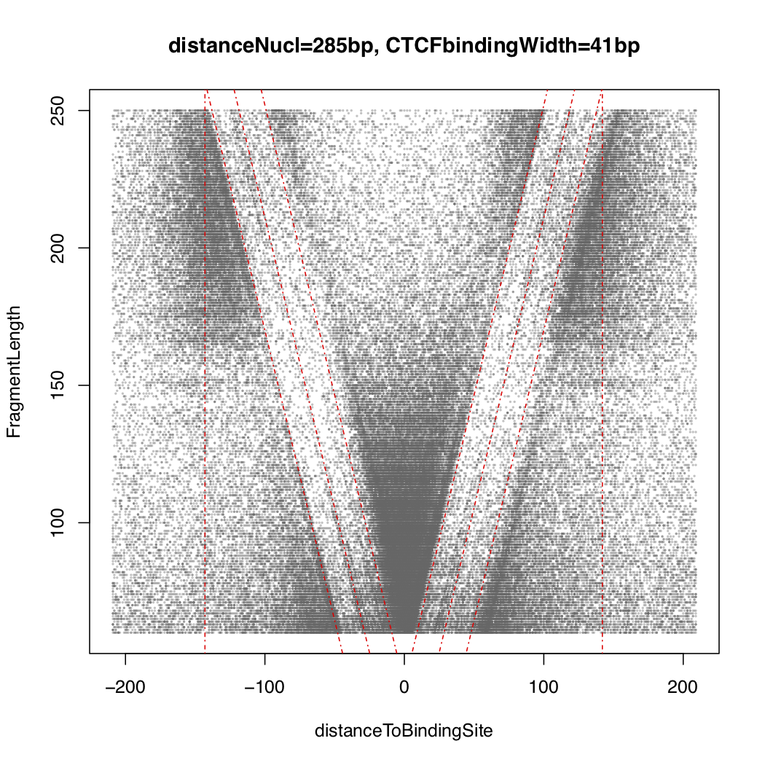
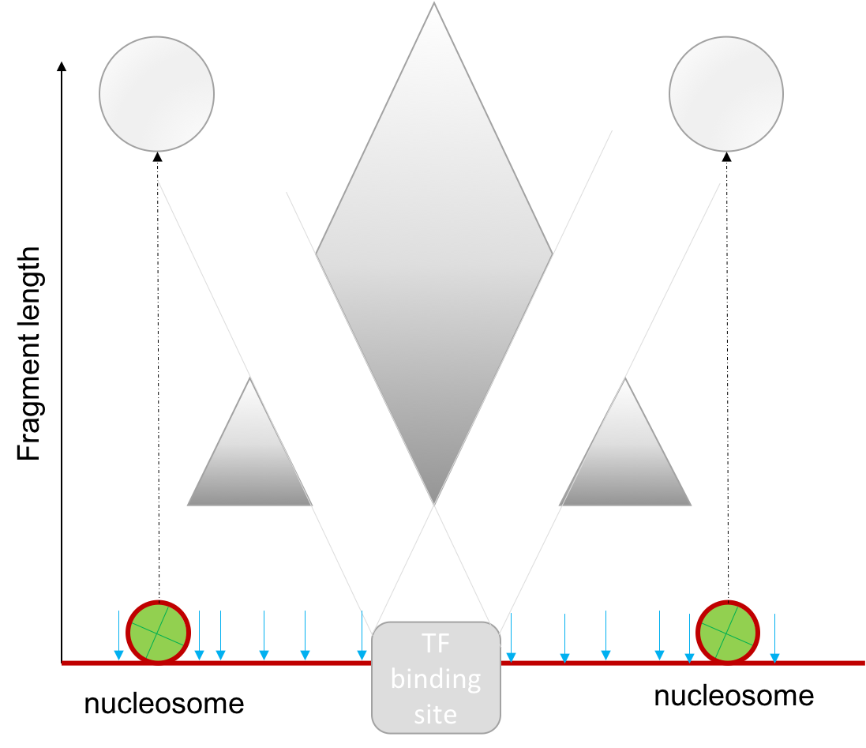
vPlot
V-plot is a plot to visualize fragment midpoint vs length for a given transcription factors.
vp <- vPlot(shiftedBamfile, pfm=CTCF[[1]],
genome=genome, min.score="90%",
seqlev=seqlev,
upstream=200, downstream=200,
ylim=c(30, 250), bandwidth=c(2, 1))
Ref: Henikoff et.al., 2011. doi: 10.1073/pnas.1110731108
Notes:
V-plot is a plot to visualize fragment midpoint vs length for a given transcription factors.
The x-axis is the distance to binding site. Y-axis is the length of fragment. The density show the reads density. Because the avoidance of binding protein, we will see a v shape plot.

Slide 35
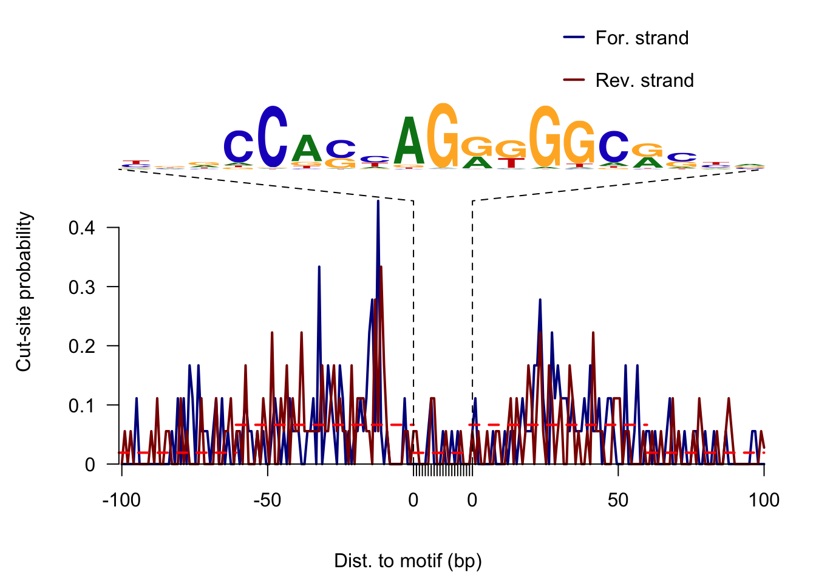
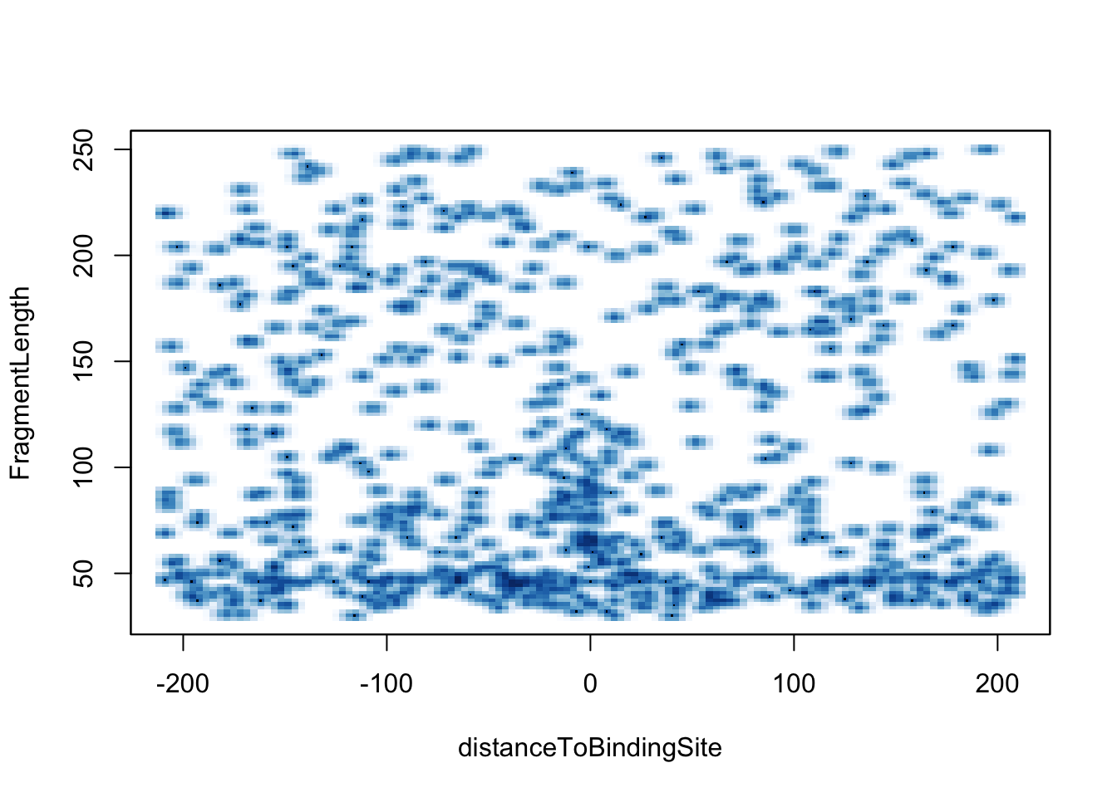
Footprints
## foot prints
library(MotifDb) CTCF <- query(MotifDb, c("CTCF")) CTCF <- as.list(CTCF)
sigs <- factorFootprints(shiftedBamfile, pfm=CTCF[[1]],
genome=genome, min.score="90%",
seqlev=seqlev,
upstream=100, downstream=100)
vp <- vPlot(shiftedBamfile, pfm=CTCF[[1]],
genome=genome, min.score="90%", seqlev=seqlev,
upstream=200, downstream=200,
ylim=c(30, 250), bandwidth=c(2, 1))
Notes:
Here we use factorFootprints and vPlot to plot the footprints and vPlot. We did not see a v-shape here is because the sample data is too small only about 10 percent of chr1.

Slide 36




ATACseqQC can …
help researcher to assess the quality of the ATAC library preparation by simple plots.
split bam files for downstream analysis and validation.
Shifted aligned reads
Splitting BAM files
Notes:
In a summary, ATACseqQC can help researcher to assess the quality of the ATAC library preparation by simple plots. In addition, it can preprocess bam files for downstream analysis.

Slide 37
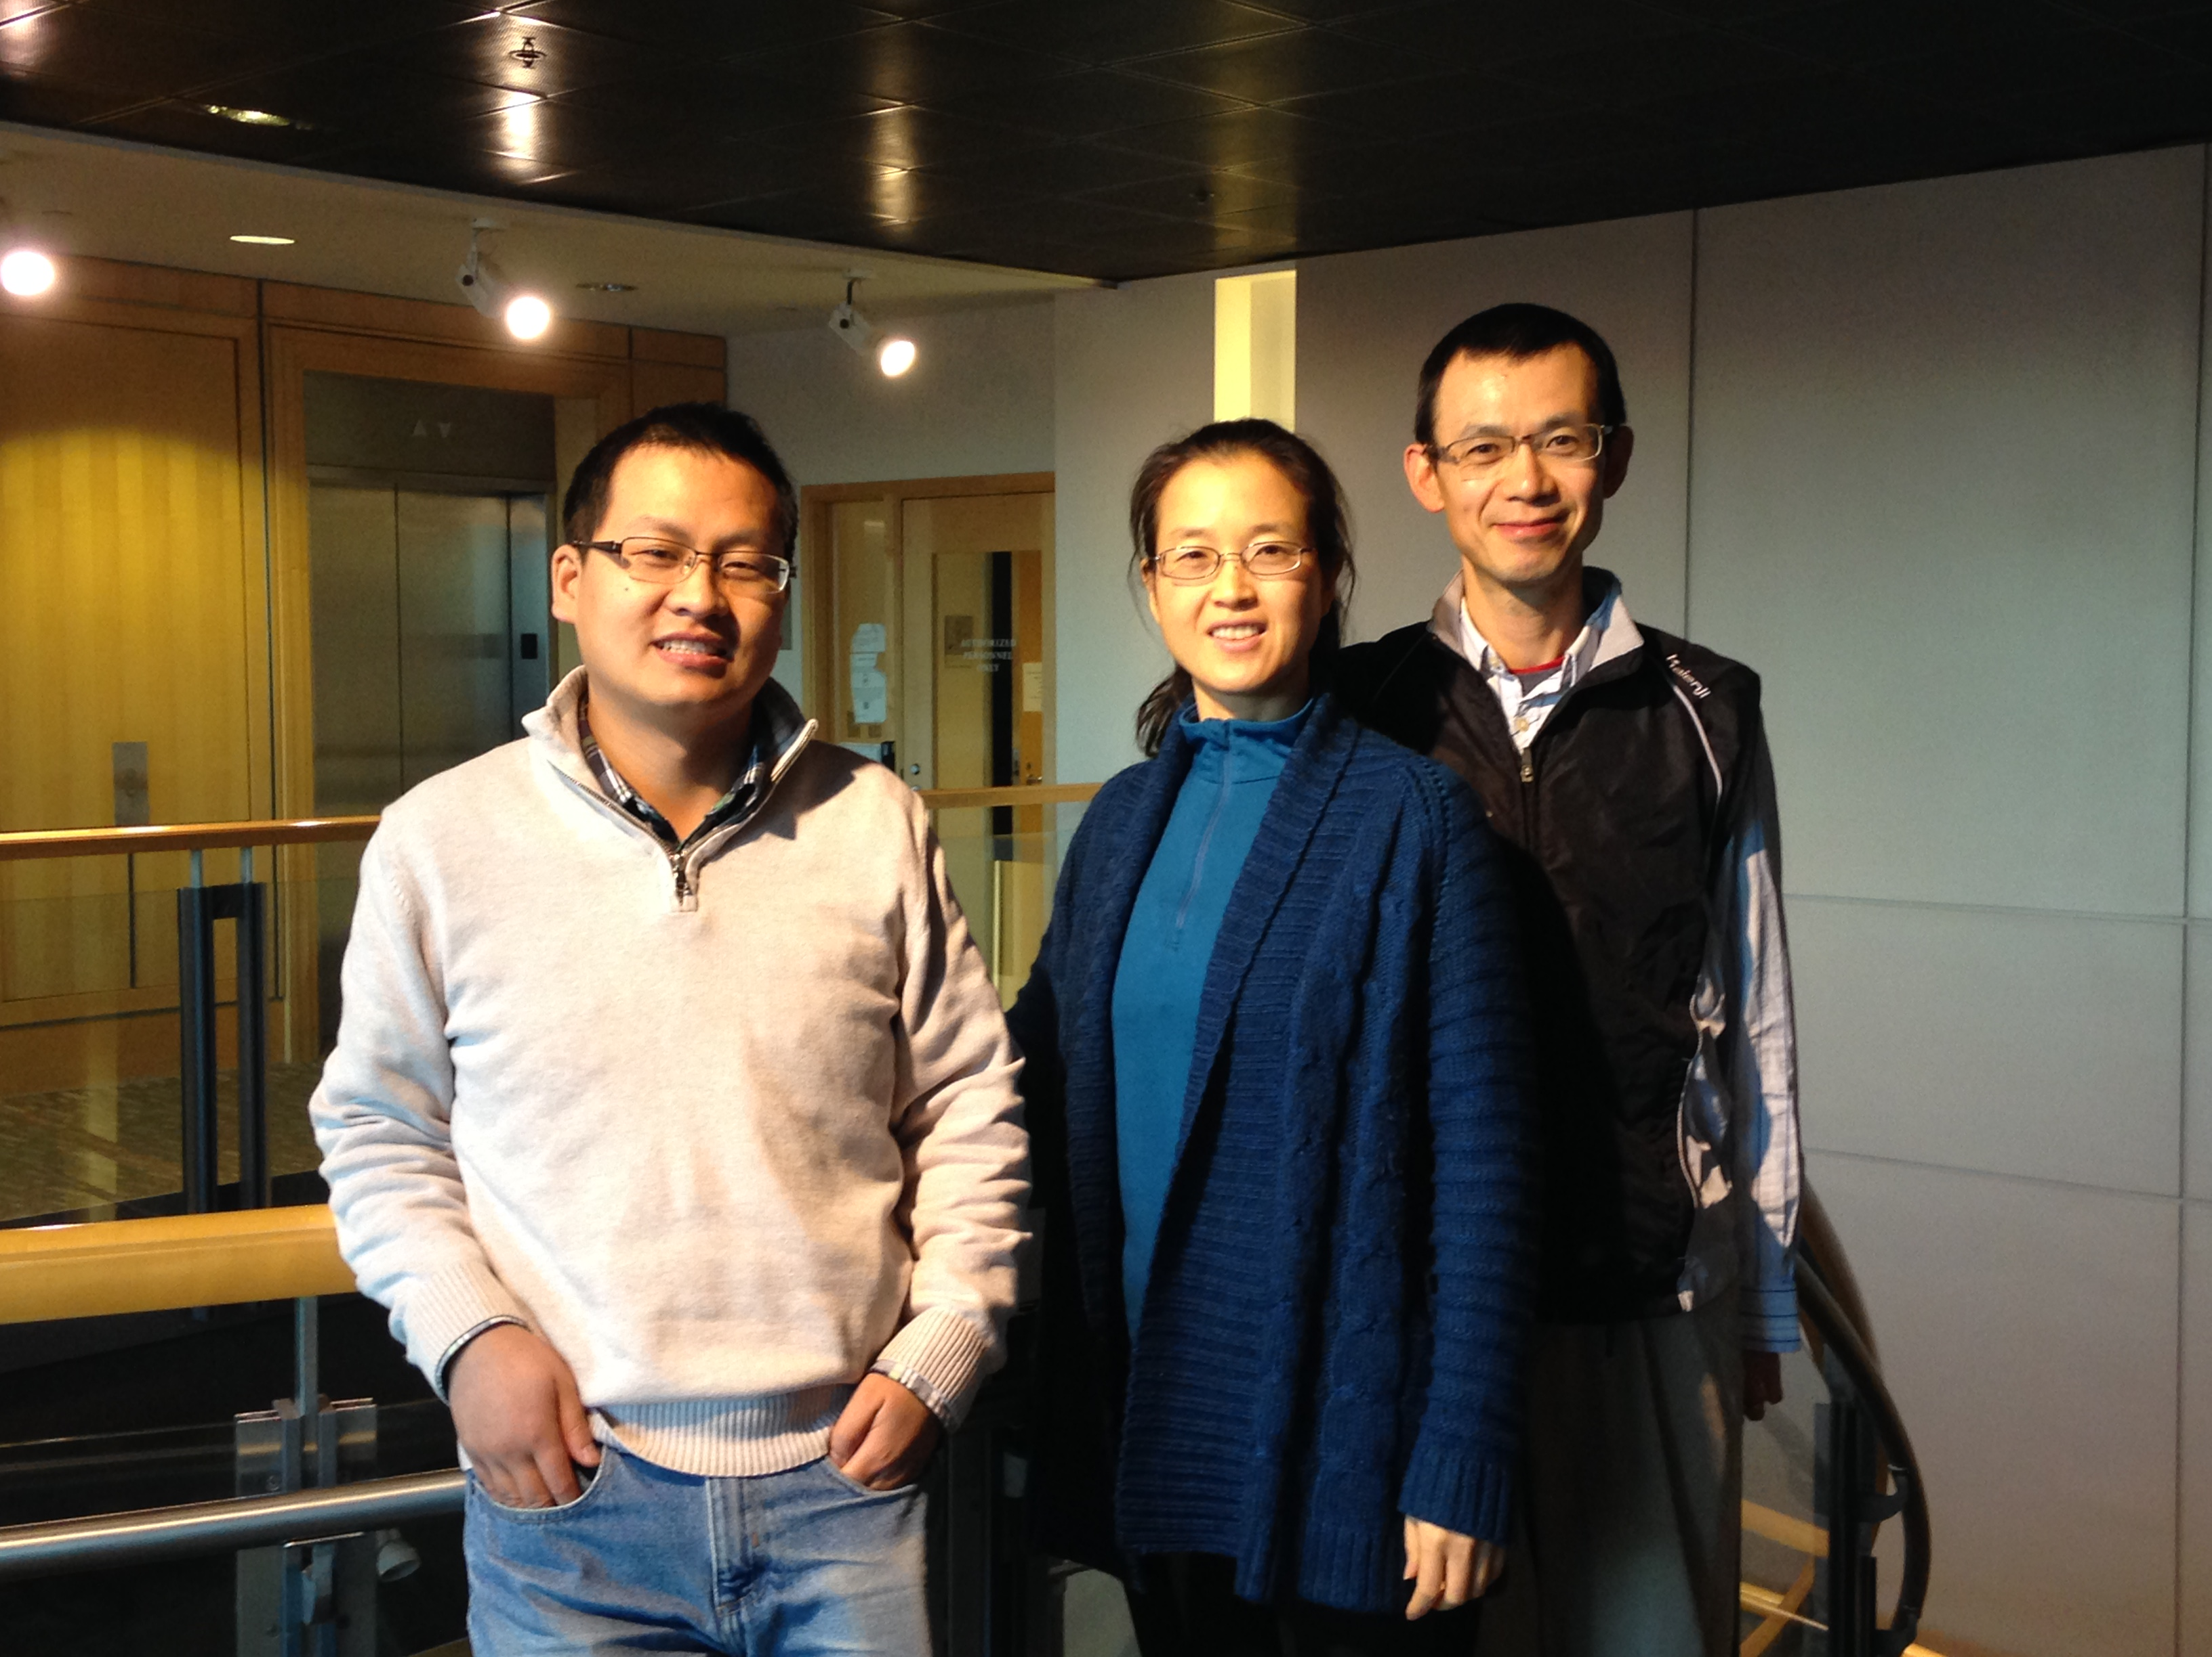

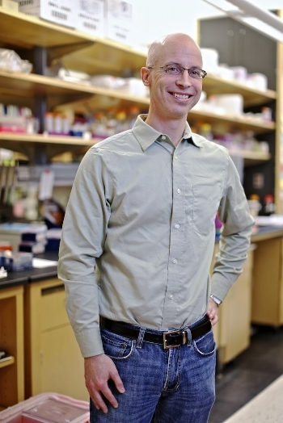
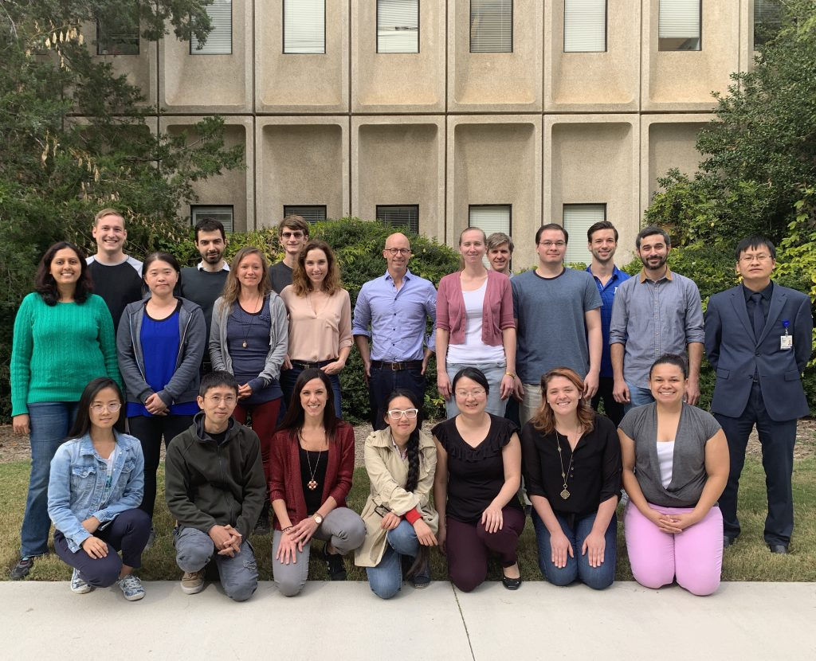
Acknowledgement
Notes:
I would like to thanks
Haibo, PhD,
Amy Dickson,
Kenneth D. Poss, Ph.D.
Julie Zhu, Ph.D.
Jun Yu, Ph.D
And all the lab members in Poss lab.
Thank you for your attention.

